Slide 1
Accurately Predict Automotive Aeroacoustic Noise for a Quieter Ride
Speaker:
Bhanu Gupta
Senior Technology Specialist
Panelist & Speaker:
Dr. Domenico Caridi
Senior Regional Fluids Product Manager

Slide 2
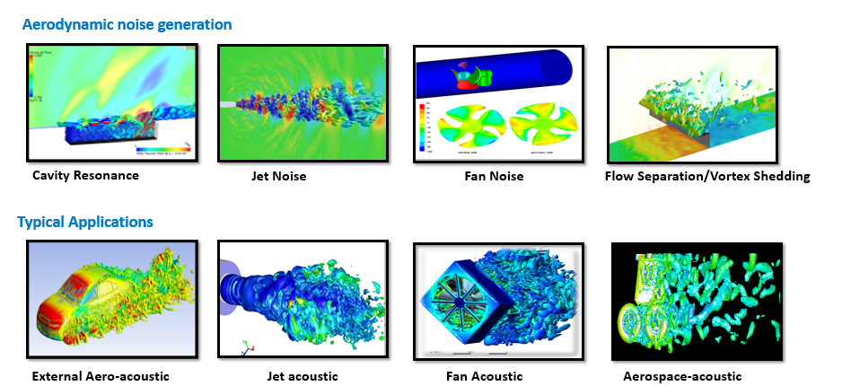
Today’s Webinar
Flow Acoustics Introduction and Acoustics Methods
Application Examples
  Fan and Blower
  Cabin Acoustics
  Tire Acoustics
  External Flow, Wind Noise
Deterministic Aero-Vibro Acoustics (DAVA)
Ansys Acoustic Solvers
VRXPERIENCE (Acoustics Post Processing)
Conclusion
Q&A
Notes:
Meshing Techniques Available, Numerics Available, Developed Metholodogy
Should any case on broadband be included

Slide 3

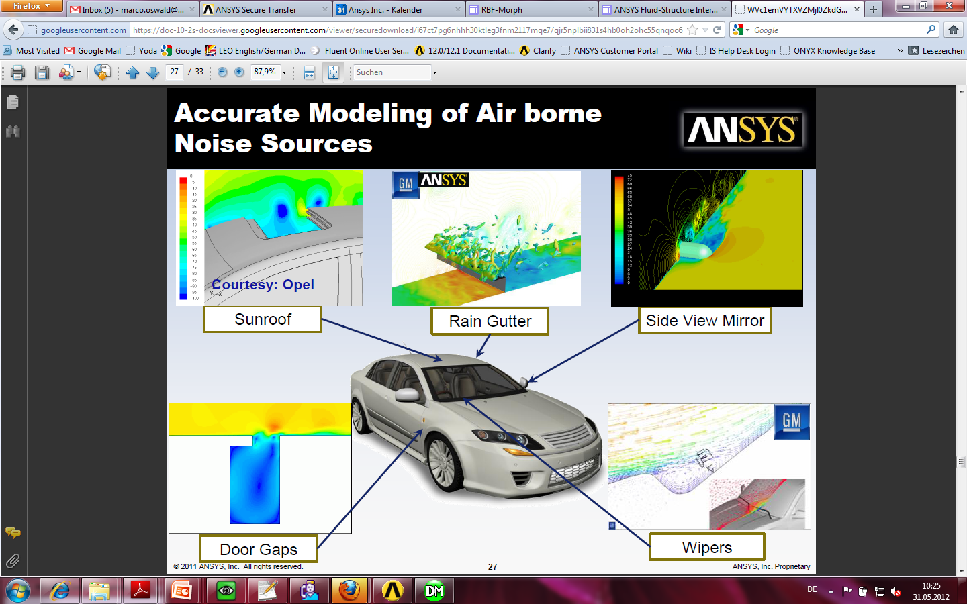
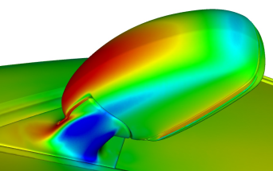
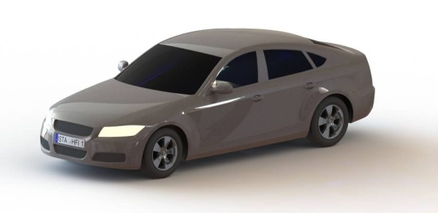

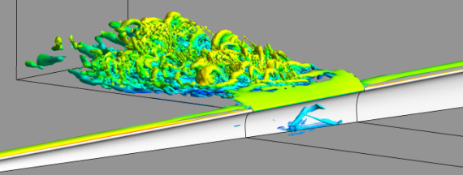
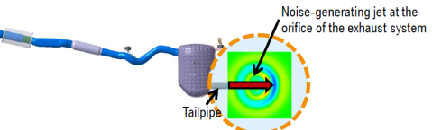


Automotive Air Born Noise Challenges
U.S. Vehicle Dependability report lists “Excessive Wind Noise” amongst the top 5 problems most commonly experienced by Vehicle Owners
J. D. Power 2014
Side view mirror
Sun Roof
Wipers
Door gaps
Exhaust
HVAC / System
Rain Gutter

Slide 4
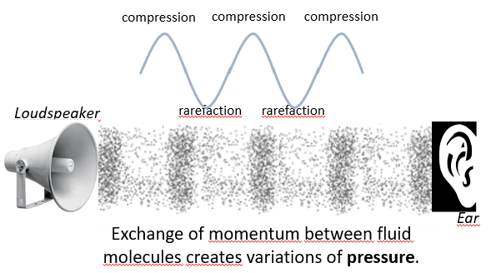
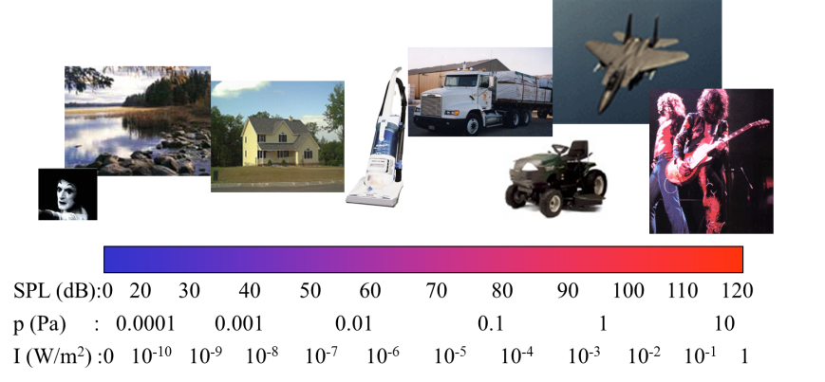
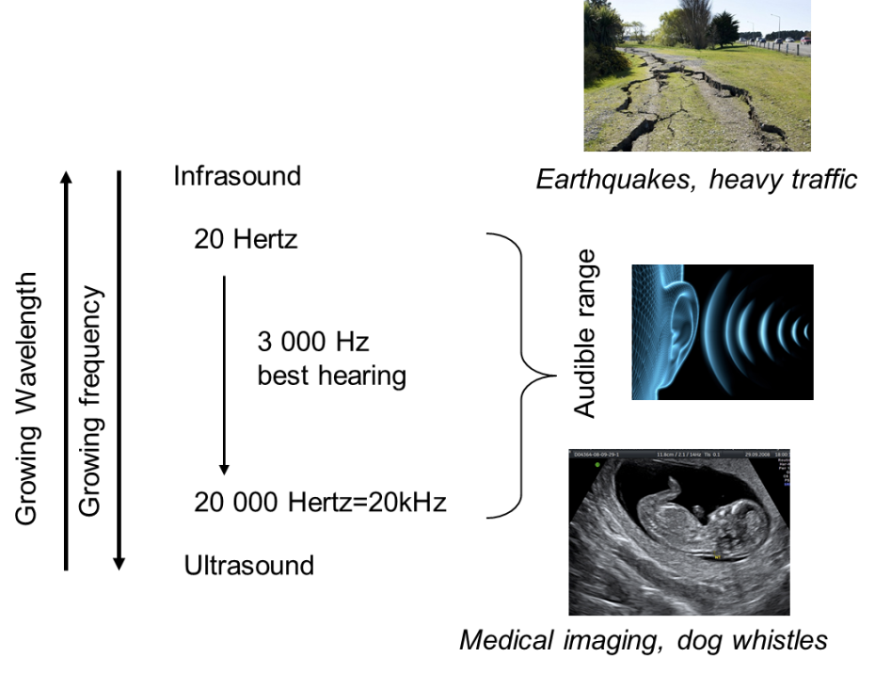
Introduction & Challenges
    Introduction
    Sound is a disturbance of the atmosphere that the human ear can hear
    Sound propagates in a continuum only!
    How does sound propagate in solid and fluid media?
    In solid medium: molecules vibrate
    In fluid medium: molecules exchange momentums
    Challenges
    Magnitude of acoustic waves is very small compared to aerodynamic pressure
    Acoustic radiation contains only tiny fraction of energy of primary flow
    Most unsteadiness in flow is ‘pseudo sound’ and doesn’t radiate
    Frequency range of interest is large, 20Hz – 20kHz
    Temporal resolution for acoustics is orders of magnitude larger than the interesting time scales in the flow
    Small eddies need to be captured, requires spatial resolution

Slide 5
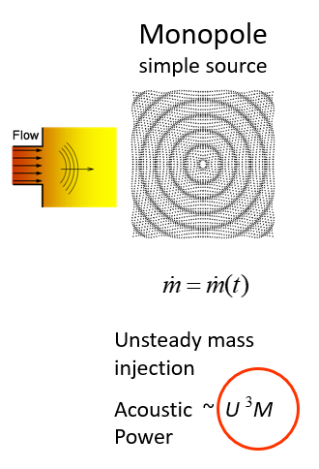
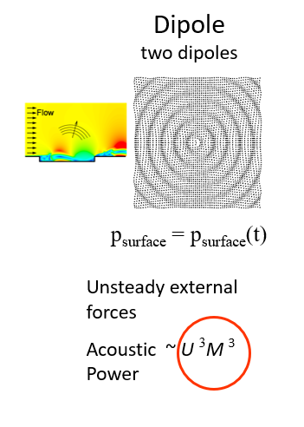
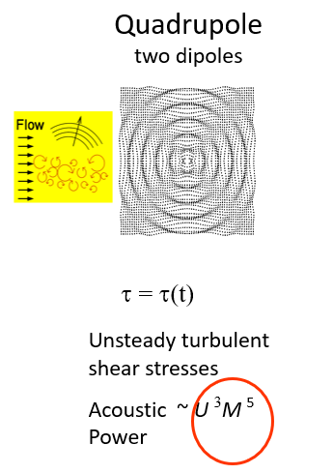



Aeroacoustic Source Classification
Monopole and dipole sources dominant at low Mach numbers
Scaling valid for acoustically compact sources, λ >> L

Slide 6
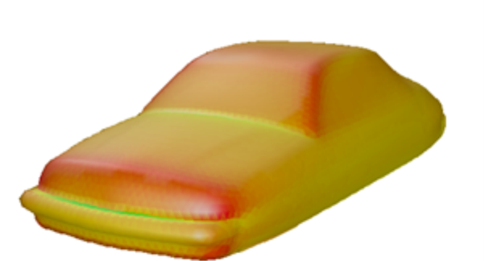
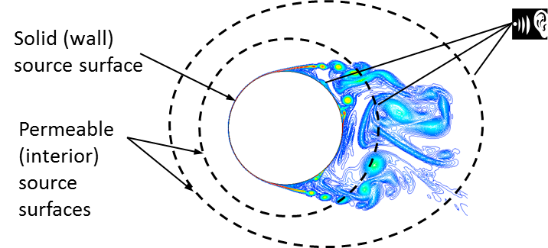
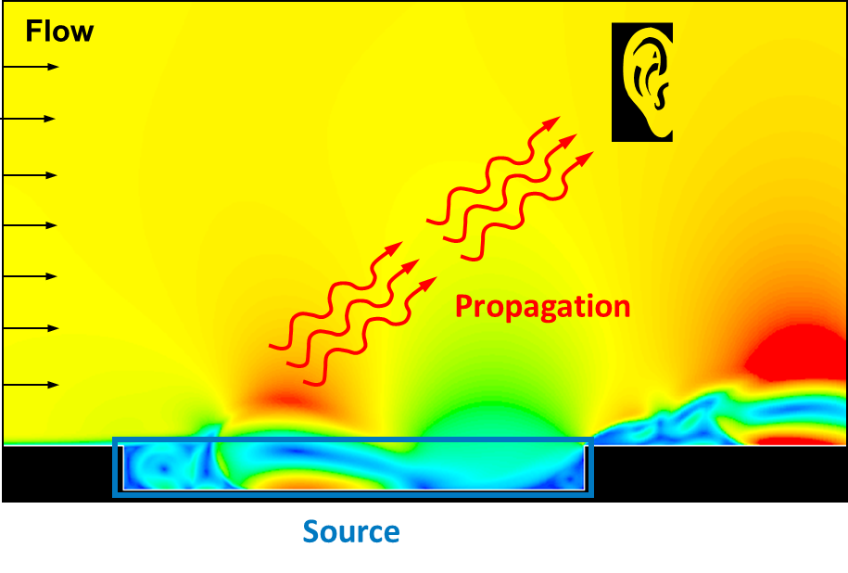
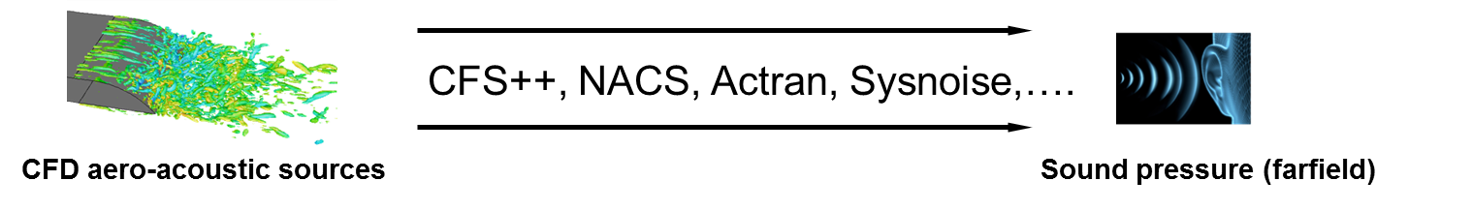
Aeroacoustics – Methods
Broadband Noise
  Sound generation is approximated using RANS results extracted from some specific surfaces or volumes. Qualitative Method for quadrupole mostly.
Surface acoustic source intensity
Broadband sources from RANS solution
Integral Methods
  Sound generation is computed with CFD and decoupled by sound propagation via analytical solution. Fluent implements FW-H Acoustic Analogy. Transient and Steady.
Solve NS equations for Source only. Propagation using analytical equations
Computational Effort
Direct Methods
  Solve Compressible CFD (source + propagation + receiver) in a fully coupled calculation of unsteady flow and acoustic fields. Often referred to as Computational Aero Acoustics
Solve NS equations for Source and propagation
Coupling Methods
Acoustic propagation using 3rd party solvers
  Couple CFD with an acoustic solver (Ansys and others)

Slide 7
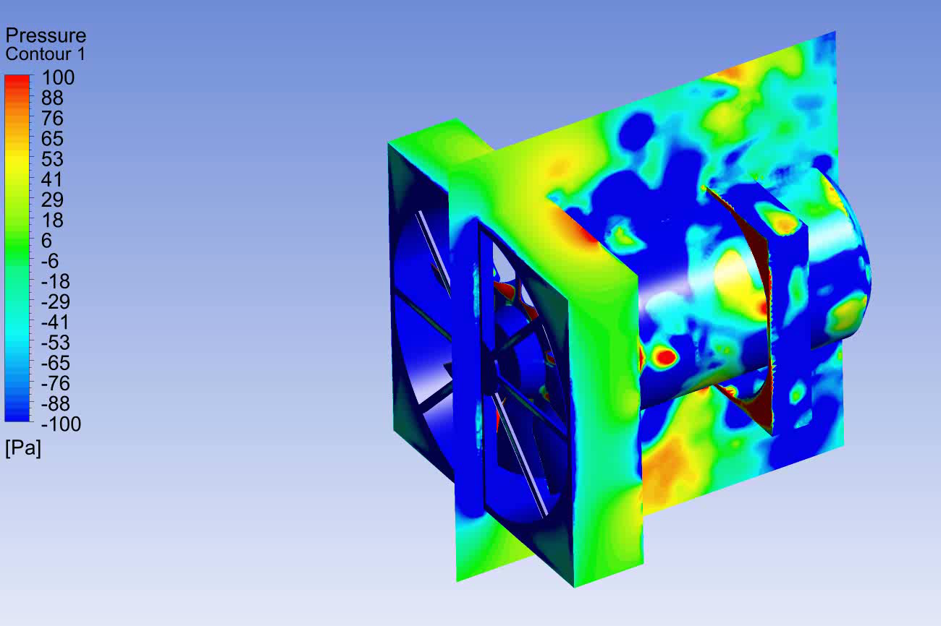
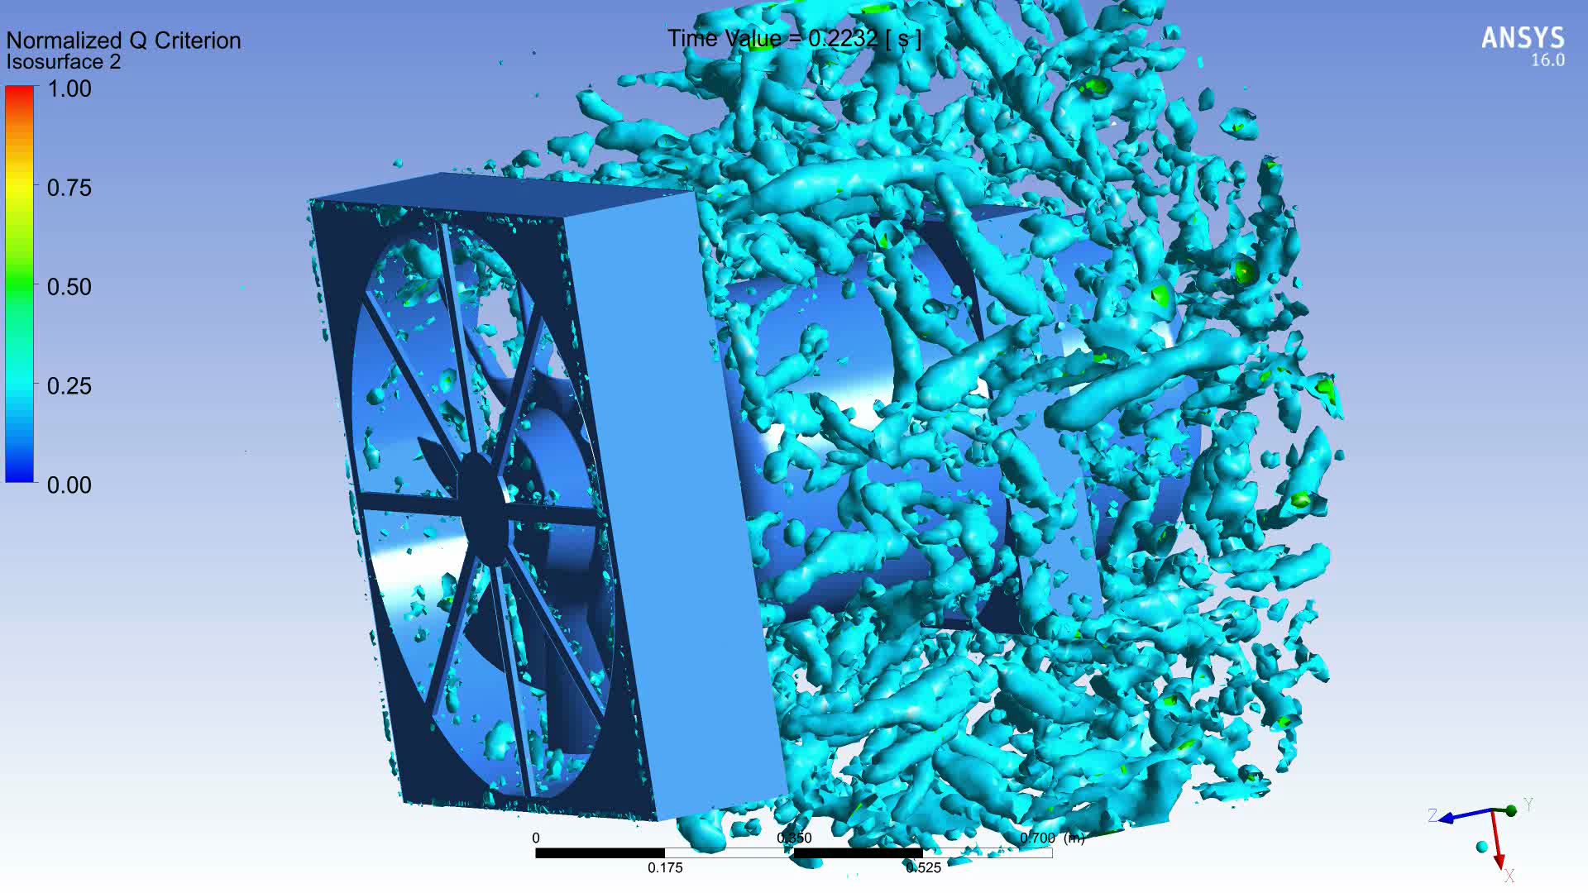
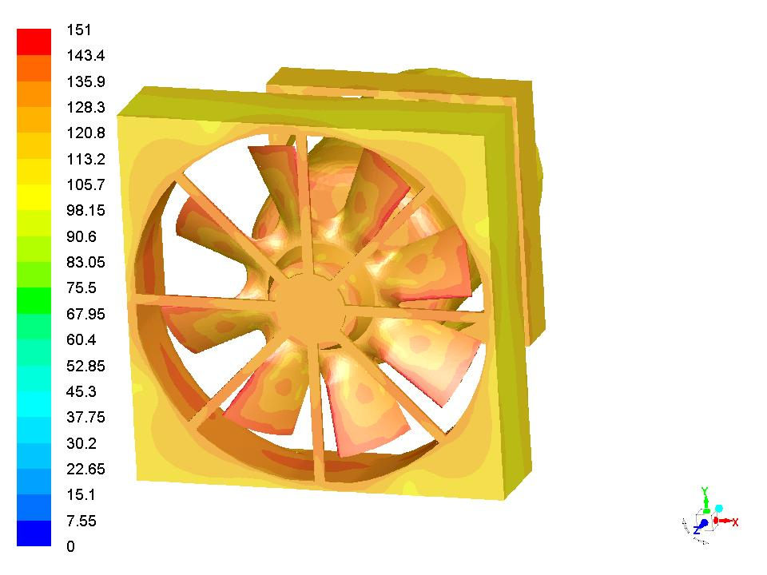
Fan Acoustics
Objective:
    Different operating condition : Speed(RPM), Operating pressure
    Different fan blade design, number of blades, different shroud design
    Noise Nature : Tonal peaks & high frequency broadband, Directivity of sound
Challenges:
    Transient Study with rotating components
    Sliding mesh
    Accurate prediction dependents on accurate turbulent flow field resolution
    Hybrid Turbulence model, Stress Blending Eddy Simulation(SBES)
Outcomes:
    Overall Noise prediction
    Blade Passing Frequency corresponding tonal noise with db levels
    Frequency Vs dB, Frequency Vs 1/3rd Octave, Spectral Density Distribution at far field and near field receiver location
    Directivity of sound study
Acoustic pressure fluctuations
Turbulence : Q criteria
BPF
dB Map – Sound source (267Hz)
Sound Spectra with Blade Passing Frequencies

Slide 8


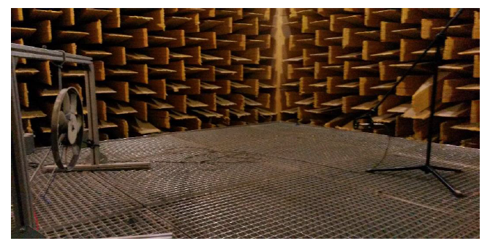
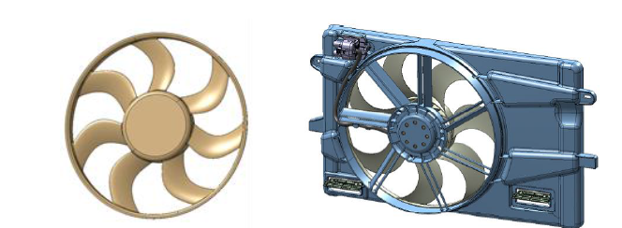
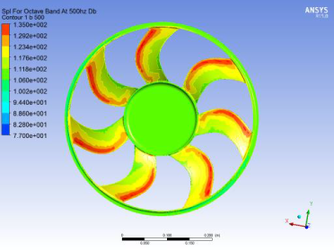
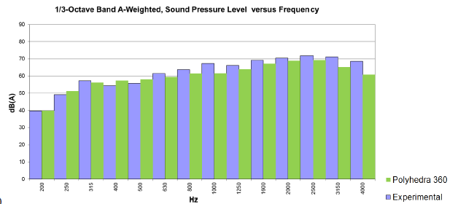
Automotive Cooling Fan example
Validation
Approach FWH: Stall Condition

Slide 9

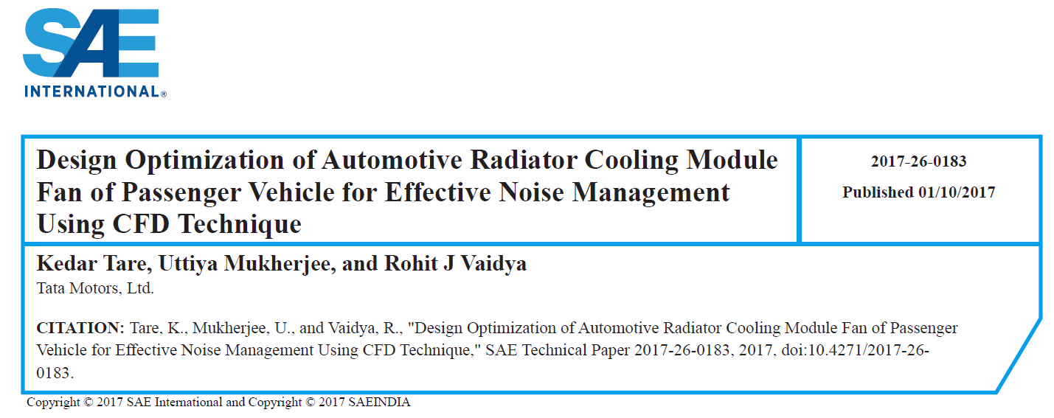
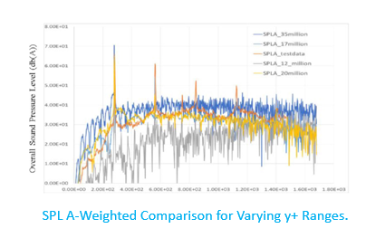
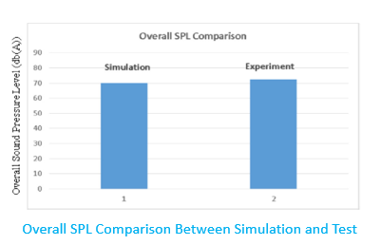
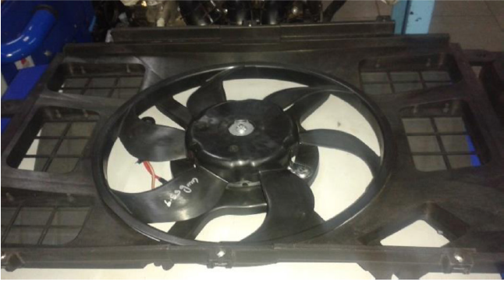
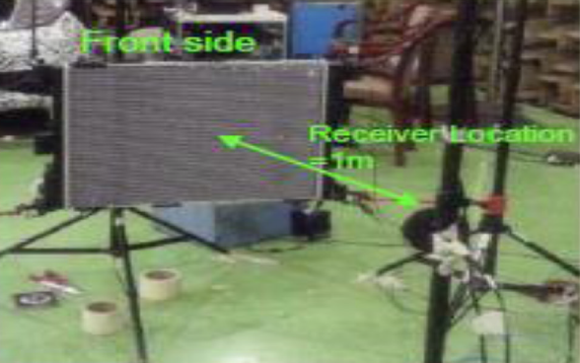
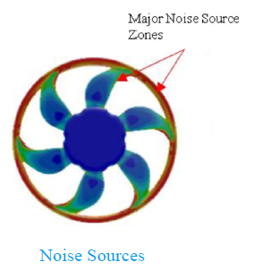
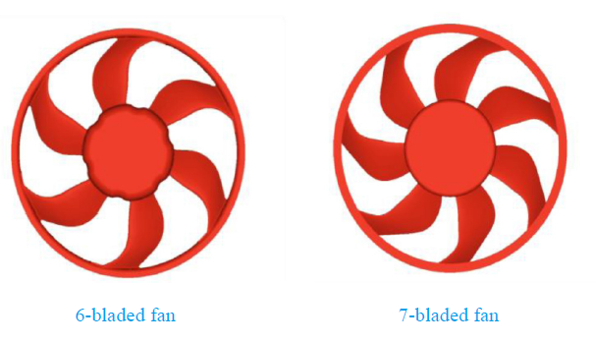
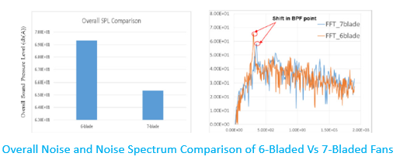
Radiator Fan example
Design Comparison & Noise Source Prediction
Approach FW-H

Slide 10
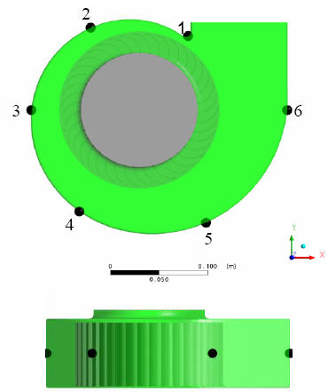
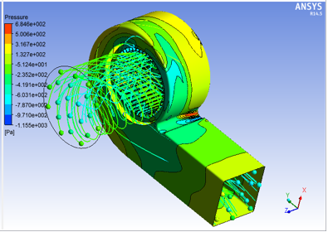
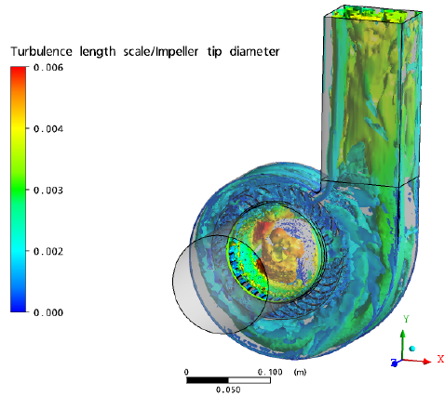
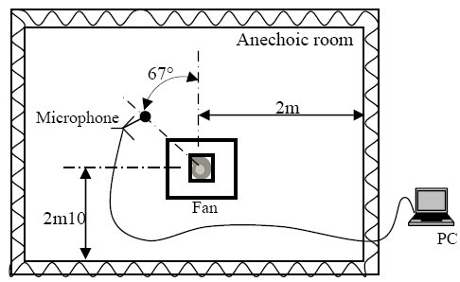
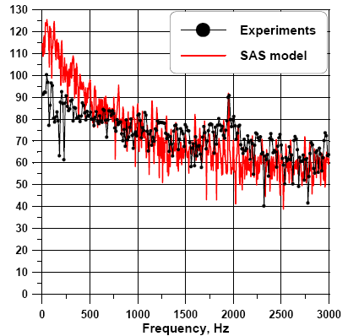
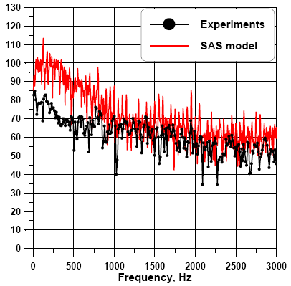
HVAC Blower Acoustics
Objective : Blower noise prediction
    Different operating condition : Speed(RPM), Operating pressure
    Different fan blade design, Number of blades, Casing design, Guiding vanes, Different grille design
    Noise level prediction inside the duct to external to duct
Challenges:
    Transient Study with rotating body: Sliding mesh
    Rotor-stator interaction
    Capturing flow and acoustic field between blade tip and stator casing critical
    High blade tip velocity
    Fine resolution of mesh on blades and between blades and casing tongue
Outcomes:
    Blade Passing Frequency corresponding tonal noise with db levels
    Understand nature of the noise
    Only broadband
    Tonal & broadband
    Noise Source spatial distribution over the components for different frequency range
Near Field Microphones
Far Field Microphones
Microphone #1
Microphone #4
Near Field Noise Prediction

Slide 11
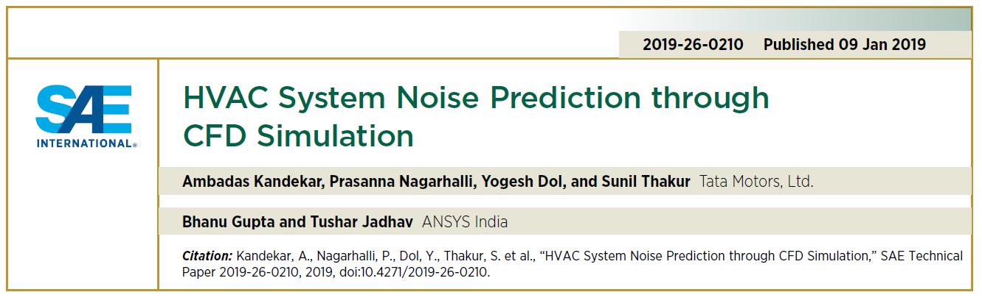
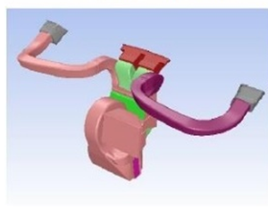
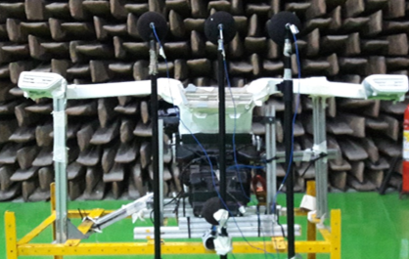
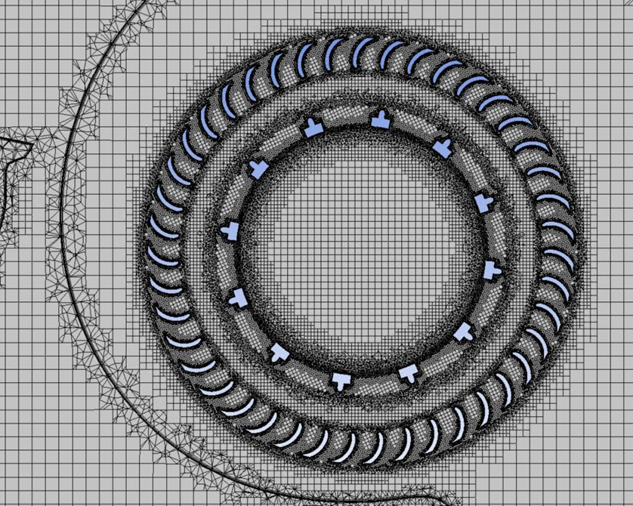
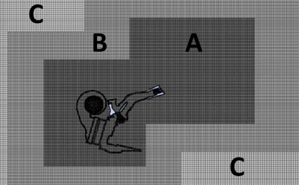
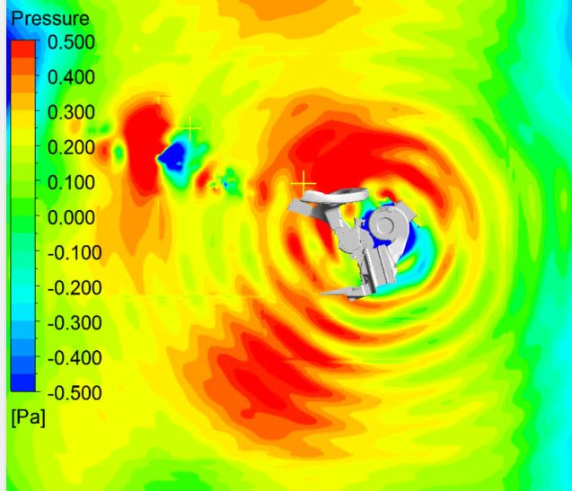
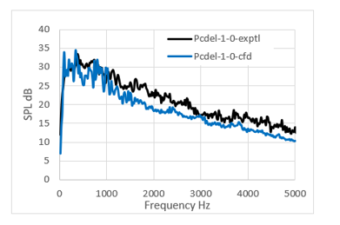
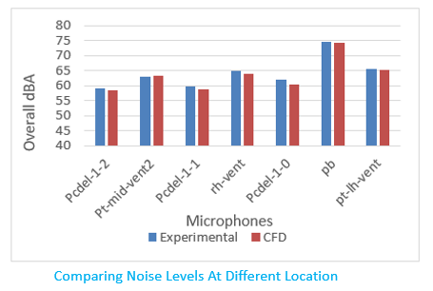
HVAC Blower and Vents example
Turbulence Model & Numerics
Approach : CAA, SBES Turbulence Model, RHOE-Flux Scheme

Slide 12
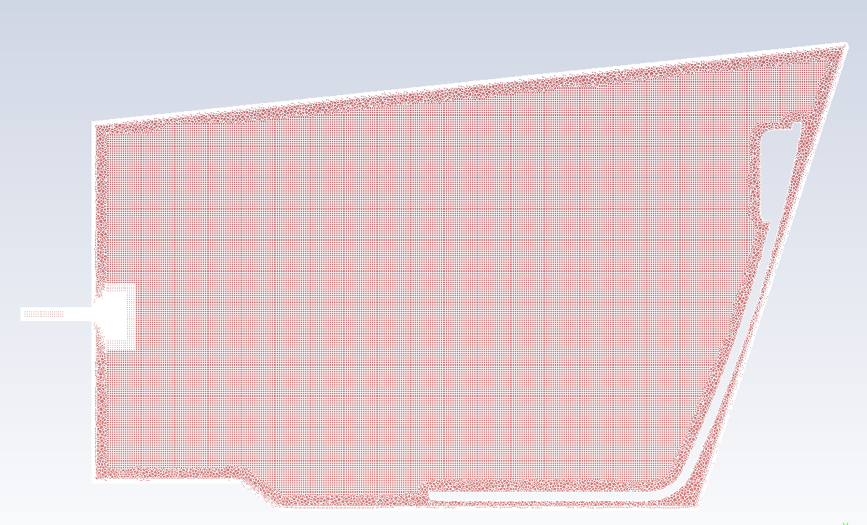
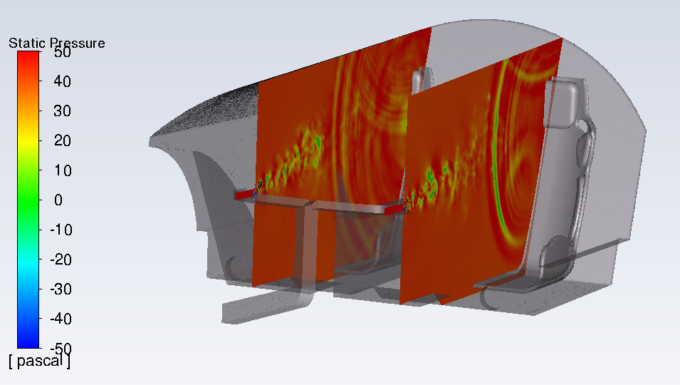
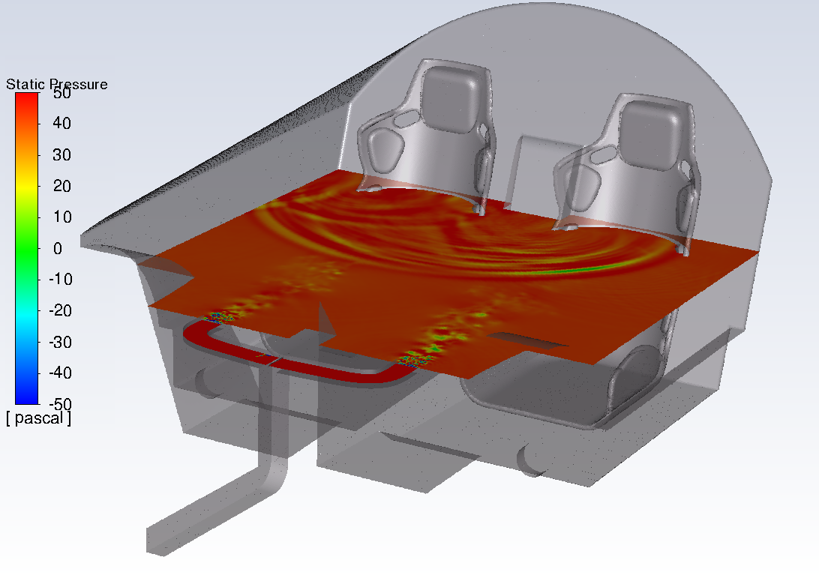
Cabin Acoustics : Blower, Duct, Vents & Cabin
Objective :
    Different HVAC operating condition
    Study different passive noise treatment. Some typical noise treatments are cabin roof material, Seats material, Side doors or dashboard materials
Challenges:
    Include the effect of passive noise treatments instead of hard wall treatment
    Impedance Boundary Treatment
    Computationally Expensive
    Mosaic Mesh (Poly-Hex Core)
Outcomes:
    Overall Noise prediction and Noise spectra at driver, co-driver and passenger ear level
    Noise contribution study from various noise sources example ducts, vents, airflow suction grille in different frequency range

Slide 13
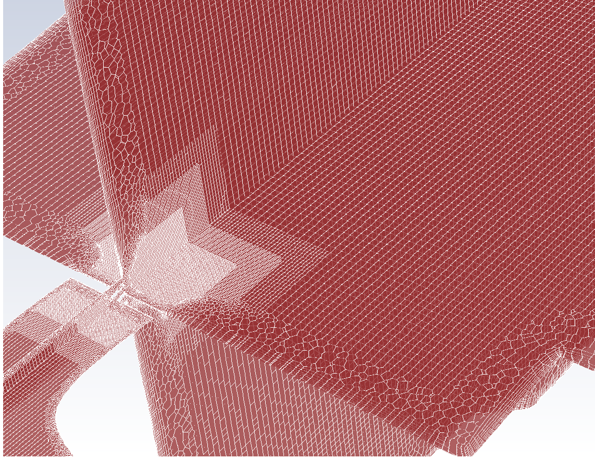
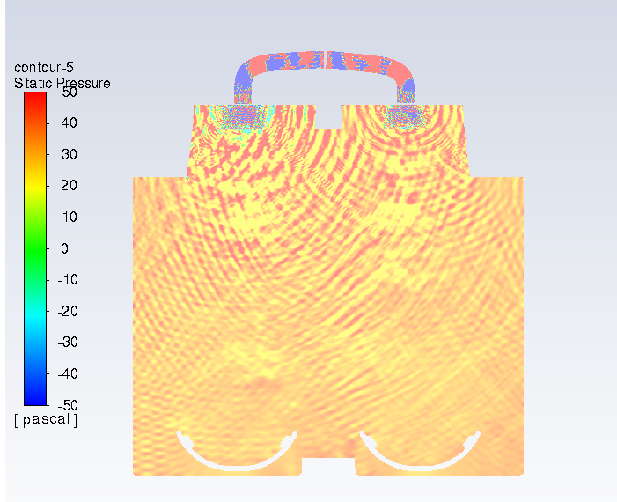


Cabin Acoustics example:
Modelling Advantage & Improved Productivity
Approach : Mosaic Mesh, Impedance boundary condition
~20-30% Solution Time Reduction
Impedance Wall, Constant Impedance over frequency range
Impedance Wall, Variable Impedance over frequency range
Cabin Top Wall
 | Overall SPL (dB) Case 1 : All Hard Walls | Overall SPL (dB) Case 2 : Windows and Seat Impedance Wall
Probe 1 : Near Seat | 77.46 | 72.58
Probe 2 : At distance of 15cm from Window 1 | 73.91 | 71.70
Probe 3 : At distance of 5cm from Window 1 | 74.26 | 68.15
Probe 4: At distance of 15cm from Window 2 | 73.92 | 71.56
Probe 5 : At distance of 5cm from Window 2 | 74.42 | 68.17
Cabin Side Wall
Cabin Rear Wall
Window 2
Seat
Pressure Inlet
Pressure Outlet
Cabin Bottom Wall

Slide 14




Tire Acoustics
Objective:
    Groove Design modification
    NVH Legislation (Next Year Expected)
    Tire aerodynamic noise for the frequency range of 1Khz-4khz
Challenges:
    Aero-acoustic noise source modeling for rotating tire
    Capturing noise with deformed tire and road interaction
    Sound Enhancement Mechanism
    Horn Effect
Outcomes:
    Overall Noise prediction
    Groove design evaluation

Slide 15









Tire Flow Induced Noise :
Capturing Pipe Resonance for Design Evaluation
CAA Approach, Non-deformed Tire been modeled
Broadband Noise 2KHz - 4 KHz is well captured and in agreement with experimental values
Pipe resonance phenomenon being captured
Frequency Vs dB(A): Trailing Edge 0.5m
Tire Impact Noise
Pipe Resonance Phenomenon
Broadband Noise

Slide 16





External Flow Aerodynamic Noise Prediction
Objective :
    Unsteady wall pressure fluctuation on car surfaces (glasses mainly)
    External Flow Noise Prediction inside Cabin (Coupling)
    Study noise generation due to various aero-dynamic design and external components like A pillar shape, side mirrors, wipers, underbody etc.
Challenges:
    Aero-Vibro Acoustics
    Complex physics and Computationally expensive
    Accurate Turbulence Models & Solver
    HPC Linear Scalability for large mesh
Outcomes:
    Noise contribution computation and visualization from various noise sources like side mirrors, wipers, underbody, other ancillaries on external body for different frequency range. Insight for design improvement
    Noise at driver's ear (coupling for in-cabin transmission(propagation)

Slide 17












Alfa-Romeo Giulietta example:
Validation
̶ Experiment
̶ Simulation
Experimental Data Courtesy of FCA - Italy
Welch periodogram, T=0.36s, Fres=16.5 Hz

Slide 18




Alfa-Romeo Giulietta example - 62M Hexcore mesh
HPC Scalability
Current Study Was done with Hexcore mesh
With latest Mosaic Mesh we have achieved simulation time cut by 20-30%
Accurate Analysis:
good for Absolute Values
Courtesy of FCA - Italy
Fast Design Screening: good for Trend Analysis
Using Optimized settings 2
T=0.18s
range 63-4000 Hz
Simulation times:
9 hours on 1,024 cores
3.2 hours on 3,072 cores
Using Conservative or Optimized settings 1
T=from 0.36s to 0.18s
range 63-4000 Hz
Simulation times:
From 40 to 13.6 hours on 1,024 cores
From 13.3 hours to 4.6 on 3,072 cores

Slide 19



Deterministic Aero Vibro Acoustics (DAVA)
Scale Resolving Transient Flow Over Car
Vibration Modeling
Side-glass, windshield
Acoustics Modeling Sound Propagation inside car
p’ (time) → p (frequency)
Deterministic Transient Loads
Velocity Mapping OR
Strongly Coupled Vibroacoustics

Slide 20

Deterministic Aero Vibro Acoustics (DAVA)
Sound generation | Sound transmission | Sound propagation
Turbulent flow simulation | Harmonic structural simulation | Harmonic acoustical simulation
Computational fluid dynamics (CFD) solver | Finite element analysis (FEA) solver | Finite element analysis (FEA) solver
Ansys Fluent | Ansys Mechanical | Ansys Mechanical
Ansys Workbench

Slide 21




Corning Inc. - SUV validation case – coupling Fluent to Mechanical Acoustics for Cabin Noise prediction
AIAA Paper

Slide 22

Ansys Acoustic Solvers: Mechanical & LS-DYNA
Finite Element Method
Boundary Element Method
Statistical Energy Analysis (SEA)
Acoustic eigenvalue analysis

Slide 23






VRXPERIENCE
Measurements
VRXPERIENCE Sound
Post-process simulated data
and test measurements
Test bench
Real situation
Listen and analyze CAE results
FLUENT
CFD simulation
Aero-acoustics
MECHANICAL
FEM simulation
Vibro-acoustics
Motion
Multi Body Dynamics

Slide 24

VRXPERIENCE
Listen simulation
rather than evaluating noises looking at curve
Define acceptability
based on psychoacoustics and Human perception
Reshape the sound
rather than simply trying
to reduce its level
Combine sources
to understand their
influence on overall noise
e.g. HVAC, Wind Noise, Tire Noise,
Engine Noise

Slide 25

Tonal peak level - What if scenario and target definition
Inputs: measurements or CFD simulation
Isolate BPF, mix, modify tonal peak level, listen and save
Tonal peak
+ 8 dB
+ 4 dB
Original
- 4 dB
- 8 dB

Slide 26



Listen from component level to system level
Transfer Function or Frequency Response Function(FRF)
Inputs: CFD time history computation, measured or simulated FRF.
Switch from component level to driver’s ears
Switch from driver’s ears to passengers’ ears
Compare designs with free field and system levels spectrums
(Binaural) FRF

Slide 27



Conclusion
Flexibility of Approaches & Boundary Condition
    CFD Acoustics: Direct method, Integral method, Broadband models, Coupling models. Boundary Conditions : Impedance BC, Non reflective BC
    Mechanical Acoustics: FEM, BEM, SEA
Accurate and Fast Solution
    Mosaic Mesh, Turbulence Modelling, Solver and HPC
Coupling For Noise Source
    Deterministic Aero-Vibro Acoustics (DAVA)
    Coupling with other Acoustic Codes
Post Processing
    Fluent Acoustic Post-Processing : FFT, SPL surface frequency bands, noise source localization
    VRXPERIENCE: Advance Acoustic Post Processing tool to add value to your CAE results

Slide 28
Thank You!
Q&A Session
email: bhanu.gupta@ansys.com
domenico.caridi@ansys.com

